Slide 1
Introductory Engineering Computer Programming ENGR 1412 International Joint Bachelor Program Environmental Engineering Lutz Pluemer

Slide 2

Welcome
Welcome to everybody.
It is my pleasure to give you this lecture today and teach you Programming in the next weeks and months.
I look forward to getting to know you better.
Maybe you are looking forward to getting to know me better as well ☺

Slide 3
Schedule and Structure of my Lecture
Schedule Programming Spring 2023 Environmental Engineering OSU Program
Algorithms, Programming, Variables, Excel Basics | Intro & Excel |  | 14-Mar-23 | Tuesday
Arrays, Tables, Charts | Excel |  | 16-Mar-23 | Wednesday
Pivot Tables | Excel |  | 21-Mar-23 | Tuesday
Jupyter, Arithmetics, Datatypes, Variables | Python |  | 28-Mar-23 | Tuesday
Casting, Math, Control Structures, Range | Python |  | 4-Apr-23 | Tuesday
Arrays, Max, Min, Mean, Std | Python |  | 11-Apr-23 | Tuesday
 |  | Midterm Exam | 13-Apr-23 | Wednesday
Functions, Sort, Median | Python |  | 18-Apr-23 | Tuesday
Modules, Strings, Lists, Dictionaries, Slicing | Python |  | 25-Apr-23 | Tuesday
Objects and Classes | Python |  | 27-Apr-23 | Wednesday
Plotting | Python |  | 9-May-23 | Tuesday
Data Analysis with NumPy and Scipy | Python |  | 16-May-23 | Tuesday
 |  | Final Exam | 18-May-23 | Wednesday

Slide 4
Schedule and Structure of my Lecture (II)
So we will meet every Tuesday and in some weeks on Wednesday as well
for three hours each: one hour lecture and two hours exercises – all in this room
for the exercises we form fixed groups of 4 students
you can choose your groups freely, preferably the way you already know each other, work together and like to spend time together
everyone brings his Laptop, we group the tables in a way that you can see each other and work together
this lecture is not about knowledge that is examined and then forgotten
but about problem solving competences
That's why exercises and homework are especially important, which is also reflected in the grading

Slide 5



The Team
Jianlin Wu (Hugh)
吴鉴霖
PhD Student
Geomatics Science and technology
Virtual geographic environment
Will support you – and me - in the exercises.
If you have any questions or need support, they are always prepared to help you.
But: Please try to find a solution for yourself first.
Jing Liu
刘静
First year graduate students
Information and Communication Engineering
search information
Lifan Lu (Chris)
卢砺凡
Senior Student of OSU-Safety Engineering
Pursuing master degree in University College London (UCL)
Will support you – and me - in the exercises. If you have any questions or need support, they are always prepared to help you. But: Please try to find a solution for yourself first.

Slide 6
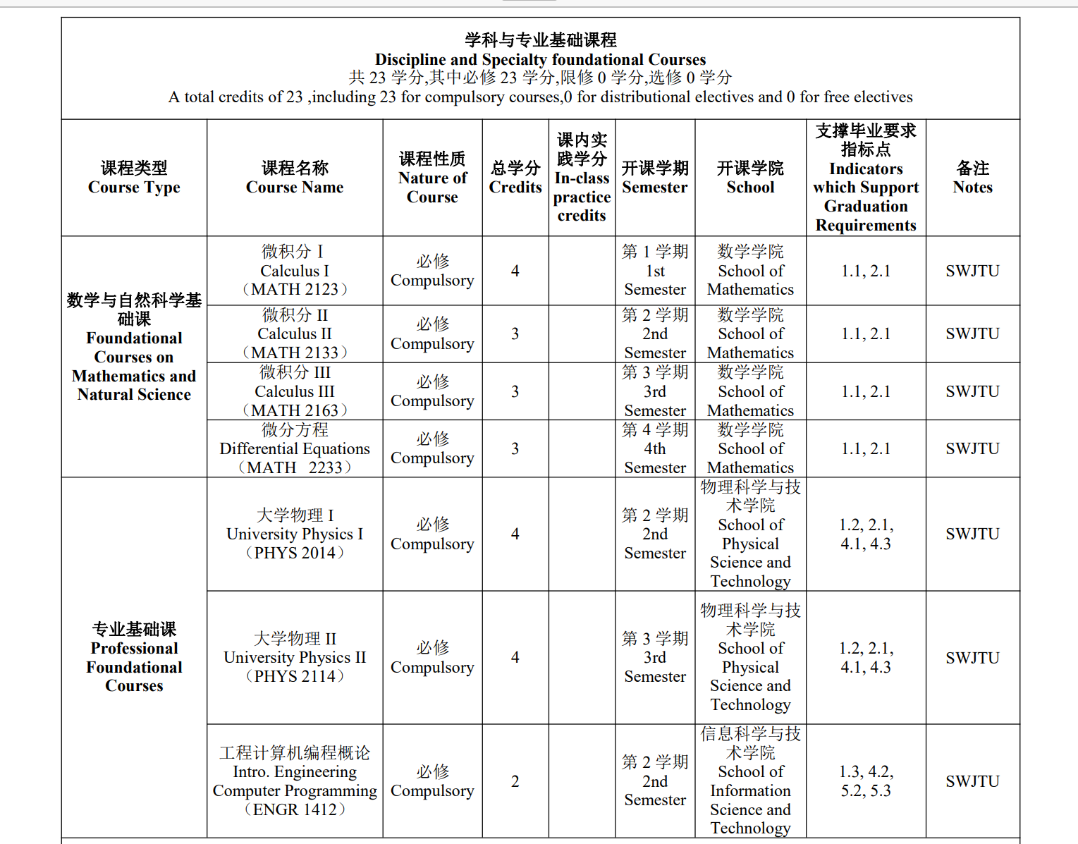
Role of my Lecture in your Study Program

Slide 7
Role of my Lecture in your Study Program
At first glance it stands there a bit isolated
It does not build on any other lecture, and is not directly the basis for anything else
So close your eyes, learn, examine and forget?
I will tell you why I believe it is a fundamental skill for your profession “Environmental Engineering”

Slide 8

Why is Programming fundamental for your Study?

Slide 9
Why is Programming fundamental for your Field of Study?
Environmental Engineering is a cross-sectional field that integrates several very different disciplines.
We train you as engineers who are called upon to prepare complex decisions that involve a lot of money
Balancing economic efficiency & environmental compatibility, sustainability
Well-founded decisions and recommendations are based on data from very different sources
And these data do not speak for themselves, but require careful analysis
And the subsequent recommendations and decisions in turn require thorough justification, based on the available data.
So it's all about data analytics. And that's where Programming comes into play.
Either you use ready-made programs - and then you need a deep understanding of what they do (more than just a block box)
Or you have to program a tool yourself

Slide 10
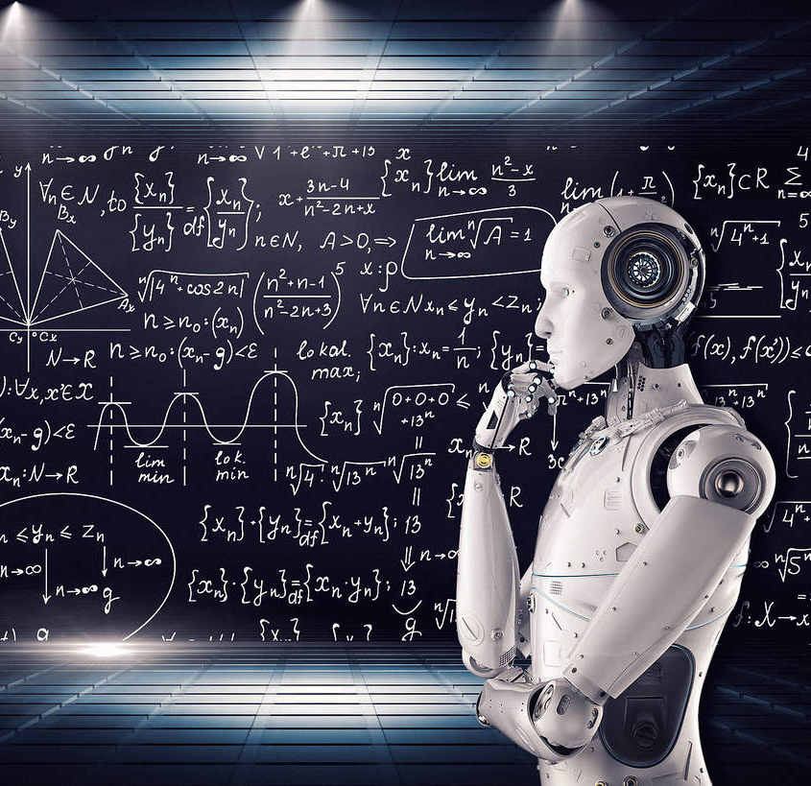
My professional Background
Studied Computer Science (Major) and Philosophy (Minor) (strange)
Got my Ph.D. in „Logic Programming“ – strong Relation to AI and Expert Systems
Served as Full Professor for Geoinformation in Bonn from 1999 to 2016 – teaching Students in Geodesy
Served as Internatiunal Dean of FGEE of SWJTU from 2018 to 2022
developed CityGML, the now internationally recognized standard for three-dimensional city and landscape models
Iinitiated the Cooperation between Agriculture and Geodesy, including modern AI-related Robotics, addressing the challenges of the digitized agriculture of the Future
Including novel methods of Data Analysis based on Machine Learning and AI
This has led to one of 57 excellence clusters in Germany
That’s where I experiences that Data Analysis is a fundamental Tool nowadays

Slide 11
My professional Background
Studied Computer Science (Major) and Philosophy (Minor)
Got my Ph.D. in Computer Science
Served as Full Professor for Geoinformation in Bonn from 1999 to 2016 – teaching Students in Geodesy
Served as International Dean of FGEE
developed CityGML, the now internationally recognized standard for three-dimensional city and landscape models
Initiated the Cooperation between Agriculture and Geodesy, including modern AI-related Robotics, addressing the challenges of the digitized agriculture of the Future, now one of 57 excellence clusters in Germany
Including novel methods of Data Analysis based on Machine Learning and AI
That’s how I learned that Data Analysis is a Fundamental Tool for deriving significant Information from raw data

Slide 12

Learning objectives
"From a problem to a program"
Structure a real-world problem and find an automated solution
Find or develop an algorithm to solve the problem
Formulate the algorithm in pseudo-code
Write a Python program
Make the Python program run
Understand Basics of the Python Programming Language
Before: Input, Management, Processing and Visualization of data in Excel

Slide 13
Central Concepts of this Lecture
Algorithm
Program

Slide 14
Algorithm
A processing instruction that is formulated so precisely that it can be carried out by a mechanically or electronically operating device at least in principle. The sequence of the individual processing steps must be clear from the precision of the linguistic representation.
Examples:
Addition, division, sorting, average
sheet music for a piece of music
To some extent:
Cooking Recipes
handicraft instructions

Slide 15

A Recipe for a typical German Cake
Wash one orange with hot water, grate the peel and squeeze out the juice. Chop the chocolate. Mix flour and baking powder.
Beat butter, sugar and 1 pinch of salt with the beaters of a hand mixer for at least 8 minutes until fluffy. Stir in eggs, one at a time, 30 sec. each. Stir in flour mixture and 5 tbsp. orange juice alternately. Divide dough into 2 halves. Stir 2 tsp. orange zest into one half. Stir cocoa powder, chocolate chips and 5 tbsp. orange juice into the second half of the dough.
Place the two doughs alternately in 4 layers in a greased loaf pan (20 cm long). Pull a fork in a spiral through the layers of dough. Bake in a hot oven at 180 degrees (convection oven 160 degrees) on the lowest rack for 50-55 min. After 10 minutes, cut lengthwise with a knife. 4.
Let the cake cool in the pan for 10 minutes, then turn it out onto a rack. Mix powdered sugar with 2-3 tbsp. orange juice and spread over cake.

Slide 16
Is this really an algorithm?
Wash one orange with hot water, grate the peel and squeeze out the juice. Chop the chocolate. Mix flour and baking powder.
Beat butter, sugar and 1 pinch of salt with the beaters of a hand mixer for at least 8 minutes until fluffy. Stir in eggs, one at a time, 30 sec. each. Stir in flour mixture and 5 tbsp. orange juice alternately. Divide dough into 2 halves. Stir 2 tsp. orange zest into one half. Stir cocoa powder, chocolate chips and 5 tbsp. orange juice into the second half of the dough.
Place the two doughs alternately in 4 layers in a greased loaf pan (20 cm long). Pull a fork in a spiral through the layers of dough. Bake in a hot oven at 180 degrees (convection oven 160 degrees) on the lowest rack for 50-55 min. After 10 minutes, cut lengthwise with a knife.
Let the cake cool in the pan for 10 minutes, then turn it out onto a rack. Mix powdered sugar with 2-3 tbsp. orange juice and spread over cake.
How does the cake get into the oven?

Slide 17
Making it more precise
Open the oven door and check if the oven - besides the the grate - contains other objects. If necessary, remove these. If not, place the cake on the rack and bake it at 180 degrees Celsius for 30 minutes. After that open the door and remove the cake. To avoid burnt fingers, this time you should use an Potholder to grip the baking pan. Then place the cake on a rack and let it cool .

Slide 18
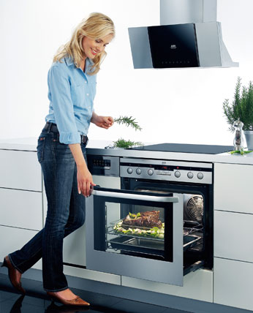
More algorithmic Style – “Pseudo Code”
Open oven door
If oven is not empty remove items that do not belong inside.
Put cake into oven and close oven
Turn oven on to 180 degrees Celsius
After 30 minutes open door
Remove cake with oven mitts
Place on a rack.
If temperature < 30 degrees - cut into 12 pieces and eat.

Slide 19
Algorithm versus Program
An algorithm, although very precise, is formulated in a natural language (English, Chinese, ...).
A program is formulated in a programming language that the computer can process and execute (Python, Java, C++, ...).
However, there is an intermediate step: the translation or compilation from a (higher) programming language into the language that the computer can execute directly (assembler)

Slide 20
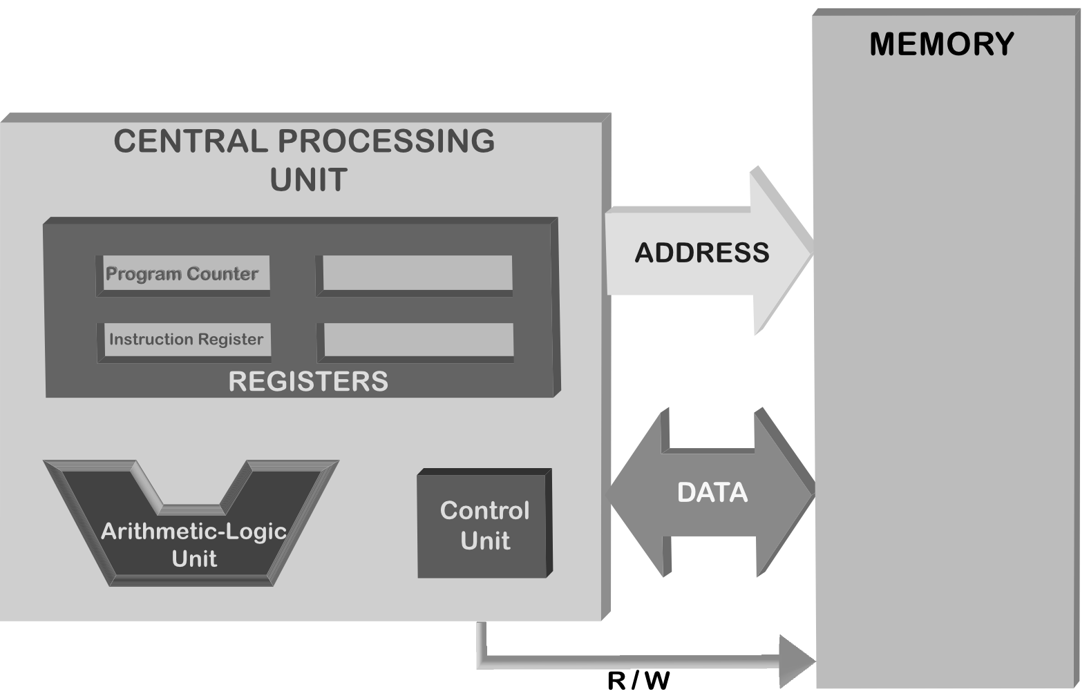
A Computer and its CPU

Slide 21
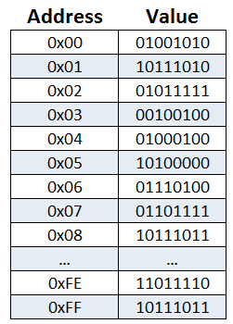
Memory Structure and Assembler Program
main:
pushq %rbp
movq %rsp, %rbp
movl alice(%rip), %edx
movl bob(%rip), %eax
imull %edx, %eax
movl %eax, carol(%rip)
movl $0, %eax
leave
ret
alice:
.long 123
bob:
.long 456

Slide 22
How to Program a Computer
Programming in Assembler with the native data types (32 or 64 bit cells) is cumbersome
It was done manually by human programmers 50 years ago when memory was very very limited (4 Megabyte for the central computer of a big university) and CPUs were very very slow
Nowadays “high level” Computer Languages such as Python are used for Programming
Using high level Data Types such as
Numbers: integer, float, complex
Characters and Texts
Date and Time
Arrays and Matrices
Compound Objects

Slide 23
Programming Languages and Paradigms
Paradigms
Imperative programming – focuses on how to execute, defines control flow by statements that change a program state.
Declarative programming – focuses on what to execute, defines program logic, but not detailed control flow.
Languages
Procedural programming – specifies the steps a program must take to reach a desired state.
Functional programming – treats programs as evaluating mathematical functions and avoids state and mutable data.
Object-oriented programming (OOP) – organizes programs as objects: data structures with attributes and methods together with their interactions.

Slide 24

Why learn Python?
Python is among the fastest-growing programming languages in the tech industry
Python is Easy to Learn and Use – and to Teach
Python provides a convenient User Interface (Jupyter)
Python has Multiple Libraries and Frameworks
Python is handy for Web Development Purposes
The Language is Extensively used in Data Analysis Python is a convenient Tool for Machine Learning and AI

Slide 25


GRADING

Slide 26

Grading
Final Exam 40%
Midterm Exam 30%
Classroom Exercises 10%
Homework 20%

Slide 27
Group work and individual assessment
Midterm and Final Exams are written exams that are graded individually.
Classroom Exercises and Homework are group work.
Groups are graded uniformly, as a rule
I assume that everyone in each group is actively participating
and that all members are able to explain the results to us when asked.
In some cases, we will also present the results of the group work to the class.
the principle "one works, the others are freeloaders" is not what I have in mind.
Each group is responsible for ensuring that this does not happen.

Slide 28

Excel

Slide 29
Excel – what is it?
Excel is not a Programming Language – it is an all-in-one Tool, suitable for many purposes
essentially it provides a very large two-dimensional array or matrix
the individual cells of this array can be of different types (integer, float, text, date, ...)
constraints can be defined between the single cells: functional relations, which are updated automatically
and the whole thing is embedded in a convenient user interface
which also allows the fast derivation of various diagrams
and finally Excel can also be used as a database, for the management of large amounts of data.

Slide 30

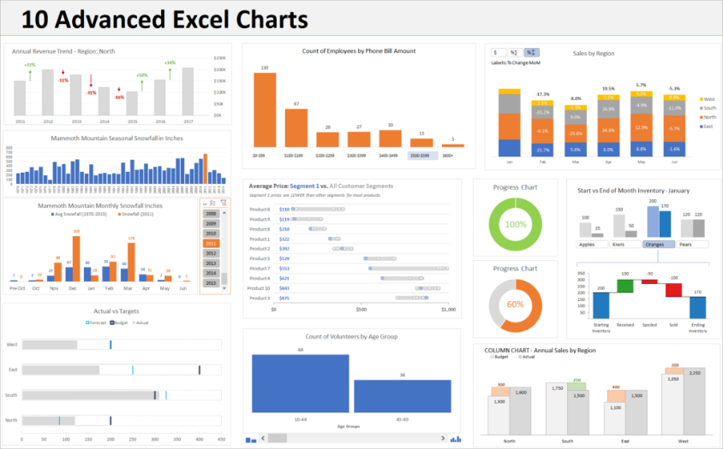
Why Teach and Learn Excel?
universal Swiss Army Knife - multi purpose
well suited for fast data analysis, provided that the data is simply structured
very well suited for fast data visualization
easy to handle
by and large self-explanatory, but it is important to work out some basics systematically
Swiss Army Knife

Slide 31
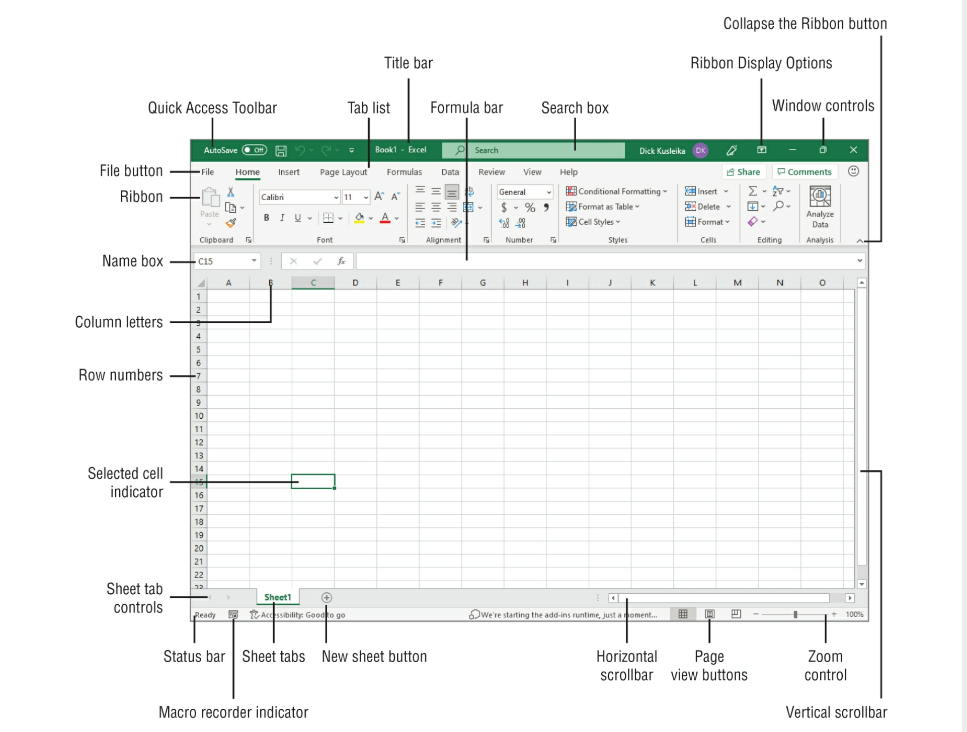
Excel Worksheet

Slide 32
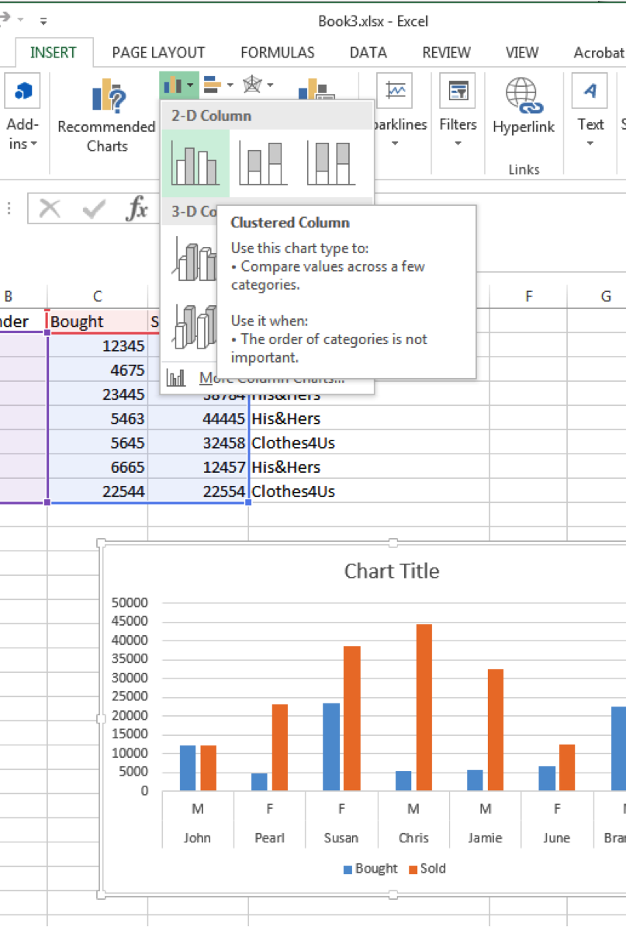
Learning Targets for the 3 Excel Lectures
Manual input of data
Reading in files
Calculations with formulas
Referencing and naming cells
Using and editing arrays and array formulas
Visualization of data with charts
Aggregation of data, Pivot Tables

Slide 33
Learning by Doing
Columns are referenced by Characters, Rows by Numbers
Go to C3 and input any number ENTER, and input 2 more numbers
By ENTER, the Input is finished and cell in the next row is activated
Go to the next row and do some arithmetic calculations such as “= 3 + 5”, “= 21 – 4, “= 5 * 15”, “= 21 / 3”
You can do calculations also by referencing cells, such as “= C3 + C4”
do the same for subtraction, multiplication, division
Next give the Cells, such as N1 for C3, N2 for C4, and N3 for C5
You now can do calculations using these names: “= N1 + N2”

Slide 34
Using Arrays and Array Formulas
An array in Excel is a structure that holds a collection of values such as numbers
Let’s start with an array of consecutive numbers in different rows, using cells D1,D2,D3,D4,D5. Input some numbers in these cells
You can reference this array via “D1:D5”
Now you can calculate the sum of these numbers by “=sum(D1:D5)”
Go to C6, input sum, and make C6 and D6 bold
You can also activate the array and name it, such as “array1”
You can calculate the mean by average(..), minimum by min(…) and maximum by max(…)
Classroom Exercise: Make an array of 10 consecutive numbers such as 17, 24, 15, 63, 19, 10, 20, 33, 38, 2
And calculate their sum, mean, maximum, and mininimum use a new Sheet2 for it, using the new sheet button

Slide 35
Types and Tables

